Slide 1
Unit 3 – Raspberry Pi with Python

Slide 2
Contents
Why raspberry pi and python
What can you do with raspberry pi and python
Writing first python application
GPIO programming using python

Slide 3
Why raspberry pi and python
Guido van Rossum created python.
In 1999, he wrote a paper called “Computer programming for Everybody” that laid out a vision for an ambitious program to teach computer programming in elementary and secondary schools using Python.
Raspberry Pi being an affordable computer makes the hardware part affordable for computer programming and python makes software part possible.

Slide 4
Why raspberry pi and python
There is a Python IDE built into Pi, called IDLE.
There are two IDLE versions available in Pi.
One for Python version 2.x and one for Python version 3.x.
A reason that Python is more popular is that there are user contributed modules that enhance standard library.
Some popular libraries for raspberry Pi are:
Rpi.GPIO – Access to GPIO pins – python-rpi.gpio
GPIOZero – Simplified access to GPIO pins – python-gpio-zero

Slide 5
Contents
Why raspberry pi and python
What can you do with raspberry pi and python
Writing first python application
GPIO programming using python

Slide 6
What can you do with raspberry pi and python
There is no shortage of interesting and creative project for raspberry pi and python:
Create picture out of text – About Me
Laser tripwire with Pi
Space data analysis – Astro Pi
A distributed computer – Octo Pi
A line following robot
Build your own weather station

Slide 7
Contents
Why raspberry pi and python
What can you do with raspberry pi and python
Writing first python application
GPIO programming using python

Slide 8
Writing first python application
This will be discussed in the lab

Slide 9
Contents
Why raspberry pi and python
What can you do with raspberry pi and python
Writing first python application
GPIO programming using python

Slide 10
GPIO programming using python
What separates raspberry pi from other Linux systems like desktop, laptop or phones is that pi can be directly used in electronics projects, because it has general-purpose input/output (GPIO) pins right on the board.
GPIO can be used to access and control hardware such as LEDs, motors and relays and other output devices.
PI can also read button status, switches, dials and sensors such as temperatures, light, motion, proximity among many others.

Slide 11
GPIO programming using python
The initial raspberry pi model had only 26 GIPO pins.
Later from the raspberry Pi 1 model b+, the number of GPIO pins were increased from 26 to 40.
An advantage of having computer with GPIO pins is that you have many different conditions to read input and control output.
Compared to a microcontroller board, raspberry pi has few extra I/O such as keyboard, mouse monitor and Ethernet port that can act as both input and output.

Slide 12
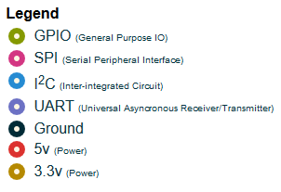
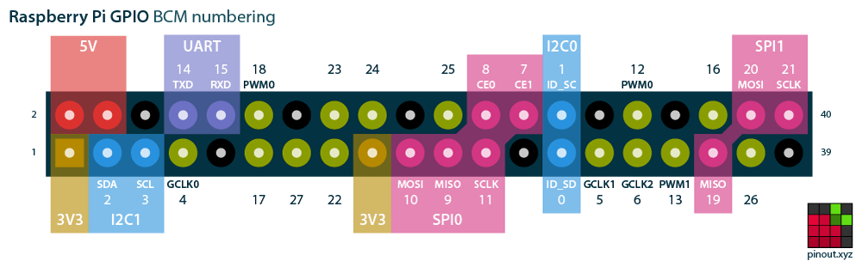
GPIO programming using python

Slide 13
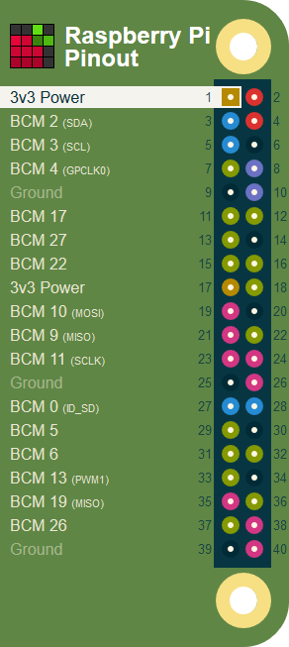
GPIO programming using python
3v3 Power
Physical pin 1
The 3v3 supply pin on the early Raspberry Pi had a maximum available current of about 50 mA. Enough to power a couple of LEDs or a microprocessor, but not much more.
All Raspberry Pi since the Model B+ can provide quite a bit more, up to 500mA to remain on the safe side, thanks to a switching regulator.
Still, you should generally use the 5v supply, coupled with a 3v3 regulator for 3.3v projects.

Slide 14
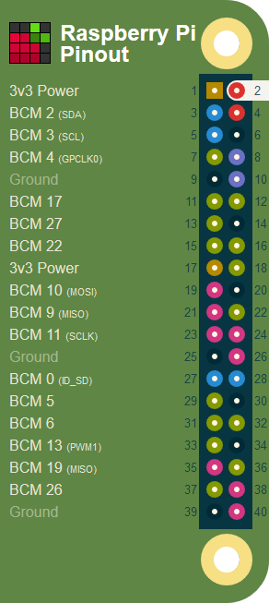
GPIO programming using python
5v Power
Physical pin 2
The 5v power pins are connected directly to the Pi's power input and will capably provide the full current of your mains adaptor, less that used by the Pi itself.
With a decent power supply, such as the official Pi adaptor, you can expect to pull about 1.5A.
Don't be disuaded by what sounds like a measly low voltage. You can do a lot with 5v. Power Arduinos, and even run a small electroluminescent wire inverter right off the 5v pin!
Spotted an error, want to add your board's pinout? Head on over to our GitHub repository and submit an Issue or a Pull Request!

Slide 15
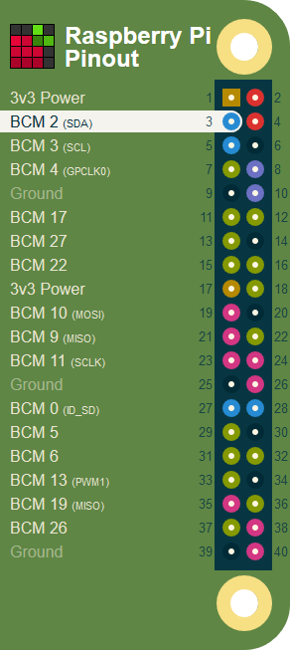
GPIO programming using python
BCM 2 (I2C Data)
Physical pin 3
BCM pin 2
Wiring Pi pin 8
BCM pin 0 on Rev 1 ( very early ) Pi
SDA (i2c Data) is one of the i2c pins on the Pi, learn more about i2c.
SDA includes a fixed, 1.8 kohms pull-up to 3.3v, which means this pin is not suitable for use as a general purpose IO where no pullup resistor is desired.

Slide 16

GPIO programming using python
The 5v power pins are connected directly to the Pi's power input and will capably provide the full current of your mains adaptor, less that used by the Pi itself.
With a decent power supply, such as the official Pi adaptor, you can expect to pull about 1.5A.
Don't be disuaded by what sounds like a measly low voltage.
You can do a lot with 5v. Power Arduinos, and even run a small electroluminescent wire inverter right off the 5v pin!

Slide 17
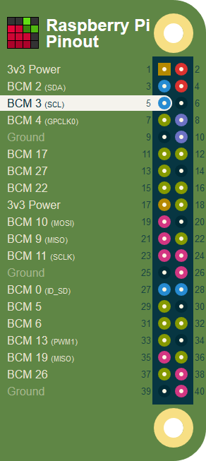
GPIO programming using python
BCM 3 (I2C Clock)
Physical pin 5
BCM pin 3
Wiring Pi pin 9
BCM pin 1 on Rev 1 ( very early ) Pi
SCL (i2c Clock) is one of the i2c pins on the Pi.
SCL includes a fixed, 1.8 kohms pull-up to 3.3v, which means this pin is not suitable for use as a general purpose IO where no pullup resistor is desired.

Slide 18
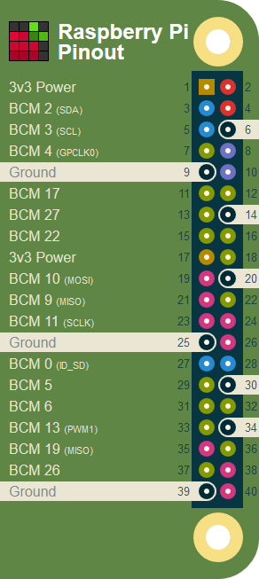
GPIO programming using python
Ground
The Ground pins on the Raspberry Pi are all electrically connected, so it doesn't matter which one you use if you're wiring up a voltage supply.
Generally the one that's most convenient or closest to the rest of your connections is tidier and easier, or alternatively the one closest to the supply pin that you use.
For example, it's a good idea to use Physical Pin 17 for 3v3 and Physical Pin 25 for ground when using the SPI connections, as these are right next to the important pins for SPI0.

Slide 19
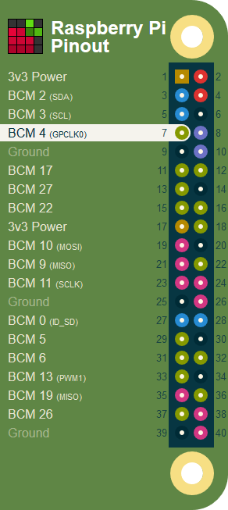
GPIO programming using python
BCM 4
Physical pin 7
BCM pin 4
Wiring Pi pin 7

Slide 20
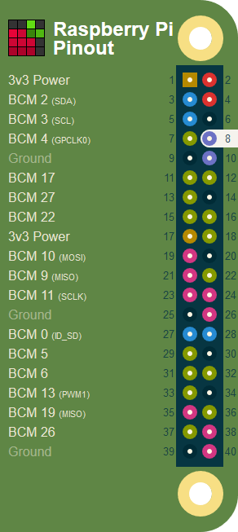
GPIO programming using python
BCM 14 (UART Transmit)
Physical pin 8
BCM pin 14
Wiring Pi pin 15
This pin doubles up as the UART transmit pin, TXD. It's also commonly known as "Serial" and, by default, will output a Console from your Pi that, with a suitable Serial cable, you can use to control your Pi via the command-line.
Thus, The UART pins are useful for setting up a "headless" Pi (a Pi without a screen) and getting it connected to a network.
UART can also be extremely useful if you want to talk to Arduino or Propeller boards from your Pi, but you must make sure you disable the Serial Console in raspi-config first.

Slide 21
GPIO programming using python
Ground
The Ground pins on the Raspberry Pi are all electrically connected, so it doesn't matter which one you use if you're wiring up a voltage supply.
Generally the one that's most convenient or closest to the rest of your connections is tidier and easier, or alternatively the one closest to the supply pin that you use.
For example, it's a good idea to use Physical Pin 17 for 3v3 and Physical Pin 25 for ground when using the SPI connections, as these are right next to the important pins for SPI0.
Details
1 pin header
Uses 8 GPIO pins

Slide 22
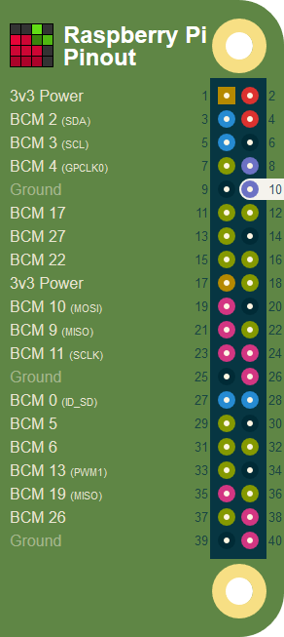
GPIO programming using python
BCM 15 (UART Receive)
Physical pin 10
BCM pin 15
Wiring Pi pin 16
This pin doubles up as the UART receive pin, RXD. It's also commonly known as "Serial" and, by default, will output a Console from your Pi that, with a suitable Serial cable, you can use to control your Pi via the command-line.
Thus, The UART pins are useful for setting up a "headless" Pi (a Pi without a screen) and getting it connected to a network.
UART can also be extremely useful if you want to talk to Arduino or Propeller boards from your Pi, but you must make sure you disable the Serial Console in raspi-config first.

Slide 23
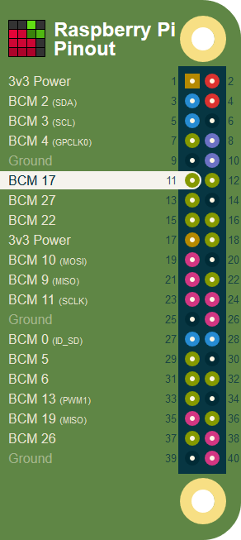
GPIO programming using python
BCM 17
Physical pin 11
BCM pin 17
Wiring Pi pin 0

Slide 24
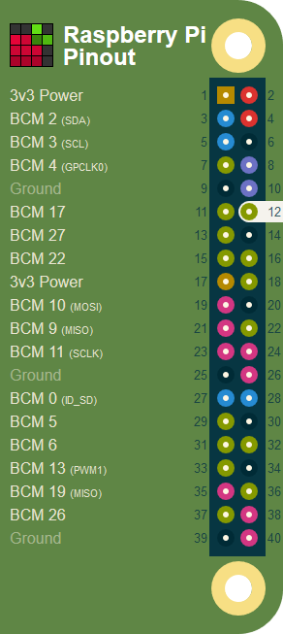
GPIO programming using python
BCM 18 (PWM0)
Physical pin 12
BCM pin 18
Wiring Pi pin 1
The PWM0 output of BCM 18 is particularly useful, in combination with some fast, direct memory access trickery, for driving tricky devices with very specific timings. The WS2812 LEDs on the Unicorn HAT are a good example of this in action.

Slide 25
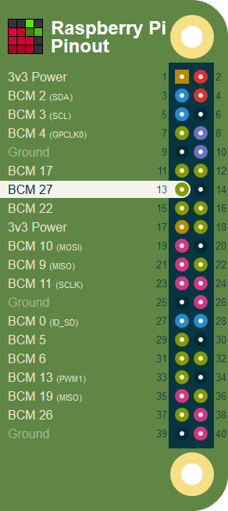
GPIO programming using python
BCM 27
Physical pin 13
BCM pin 27
Wiring Pi pin 2
BCM pin 21 on Rev 1 ( very early ) P

Slide 26
GPIO programming using python
Ground
The Ground pins on the Raspberry Pi are all electrically connected, so it doesn't matter which one you use if you're wiring up a voltage supply.
Generally the one that's most convenient or closest to the rest of your connections is tidier and easier, or alternatively the one closest to the supply pin that you use.
For example, it's a good idea to use Physical Pin 17 for 3v3 and Physical Pin 25 for ground when using the SPI connections, as these are right next to the important pins for SPI0.
Details
1 pin header
Uses 8 GPIO pins

Slide 27
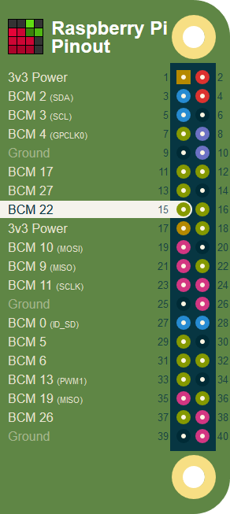
GPIO programming using python
BCM 22
Physical pin 15
BCM pin 22
Wiring Pi pin 3

Slide 28
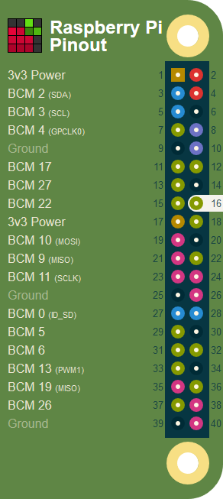
GPIO programming using python
BCM 23
Physical pin 16
BCM pin 23
Wiring Pi pin 4

Slide 29
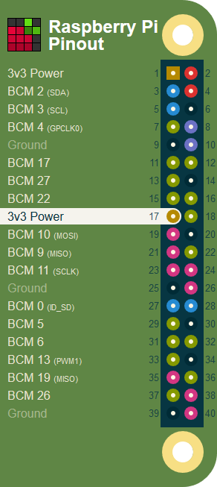
GPIO programming using python
3v3 Power
Physical pin 17
The 3v3 supply pin on the early Raspberry Pi had a maximum available current of about 50 mA. Enough to power a couple of LEDs or a microprocessor, but not much more.
All Raspberry Pi since the Model B+ can provide quite a bit more, up to 500mA to remain on the safe side, thanks to a switching regulator.
Still, you should generally use the 5v supply, coupled with a 3v3 regulator for 3.3v projects.

Slide 30
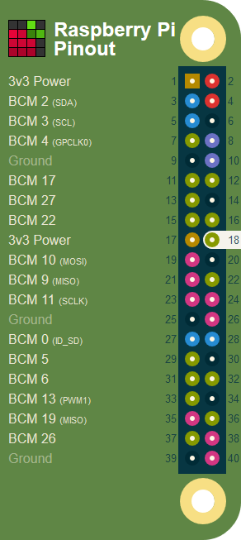
GPIO programming using python
BCM 24
Physical pin 18
BCM pin 24
Wiring Pi pin 5

Slide 31
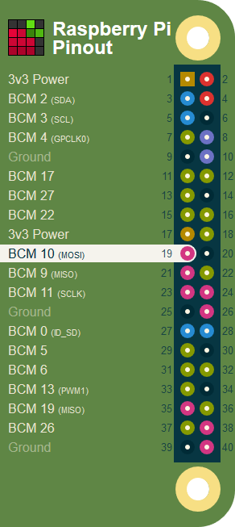
GPIO programming using python
BCM 10
Physical pin 19
BCM pin 10
Wiring Pi pin 12

Slide 32
GPIO programming using python
Ground
The Ground pins on the Raspberry Pi are all electrically connected, so it doesn't matter which one you use if you're wiring up a voltage supply.
Generally the one that's most convenient or closest to the rest of your connections is tidier and easier, or alternatively the one closest to the supply pin that you use.
For example, it's a good idea to use Physical Pin 17 for 3v3 and Physical Pin 25 for ground when using the SPI connections, as these are right next to the important pins for SPI0.
Details
1 pin header
Uses 8 GPIO pins

Slide 33
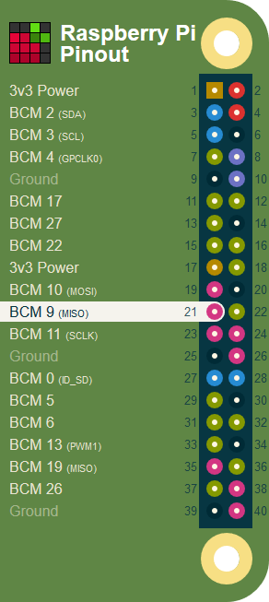
GPIO programming using python
BCM 9
Physical pin 21
BCM pin 9
Wiring Pi pin 13

Slide 34
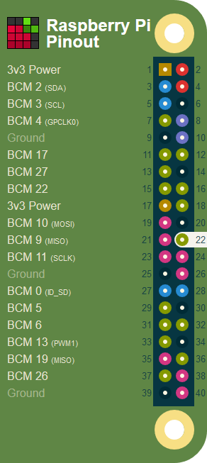
GPIO programming using python
BCM 25
Physical pin 22
BCM pin 25
Wiring Pi pin 6

Slide 35
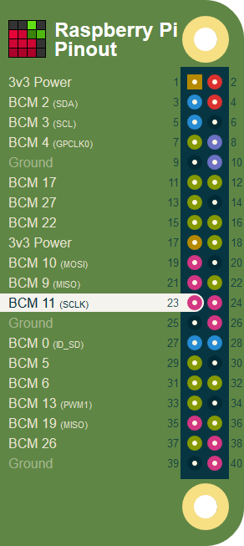
GPIO programming using python
BCM 11
Physical pin 23
BCM pin 11
Wiring Pi pin 14

Slide 36
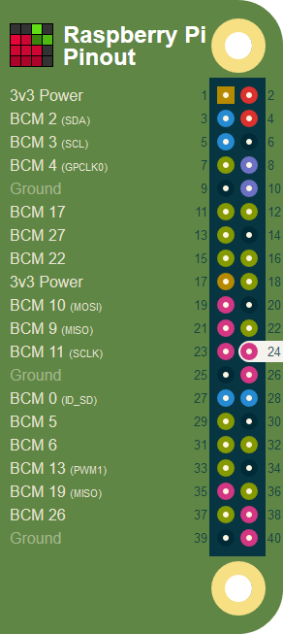
GPIO programming using python
BCM 8 (SPI Chip Select 0)
Physical pin 24
BCM pin 8
Wiring Pi pin 10

Slide 37
GPIO programming using python
Ground
The Ground pins on the Raspberry Pi are all electrically connected, so it doesn't matter which one you use if you're wiring up a voltage supply.
Generally the one that's most convenient or closest to the rest of your connections is tidier and easier, or alternatively the one closest to the supply pin that you use.
For example, it's a good idea to use Physical Pin 17 for 3v3 and Physical Pin 25 for ground when using the SPI connections, as these are right next to the important pins for SPI0.
Details
1 pin header
Uses 8 GPIO pins

Slide 38
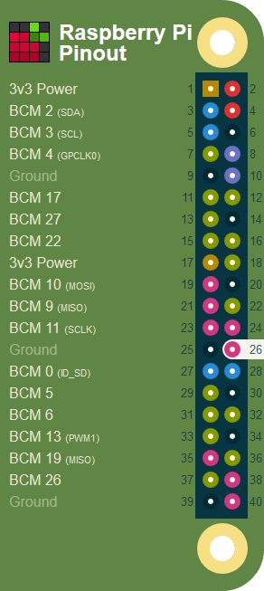
GPIO programming using python
BCM 7 (SPI Chip Select 1)
Physical pin 26
BCM pin 7
Wiring Pi pin 11

Slide 39
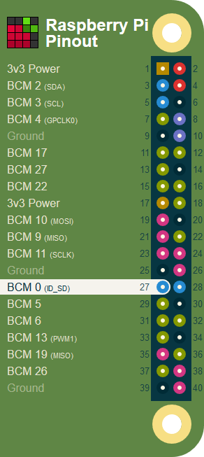
GPIO programming using python
BCM 0 (HAT EEPROM i2c Data)
Physical pin 27
BCM pin 0
Wiring Pi pin 30
These pins are generally reserved for i2c communication with an EEPROM.
Connect those pins for auto configuration, if the board provides the feature (check the board description for details of EEPROM functionality).

Slide 40
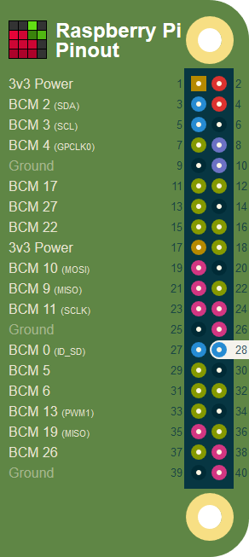
GPIO programming using python
BCM 1 (HAT EEPROM i2c Clock)
Physical pin 28
BCM pin 1
Wiring Pi pin 31
These pins are generally reserved for i2c communication with an EEPROM.
Connect those pins for auto configuration, if the board provides the feature (check the board description for details of EEPROM functionality).

Slide 41
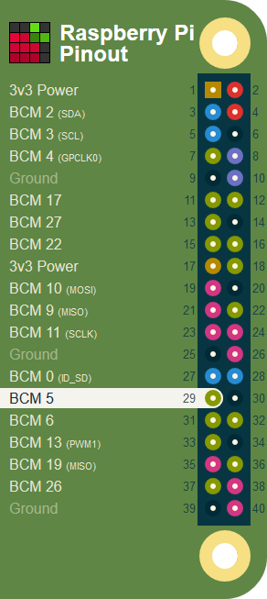
GPIO programming using python
BCM 5
Physical pin 29
BCM pin 5
Wiring Pi pin 21

Slide 42
GPIO programming using python
Ground
The Ground pins on the Raspberry Pi are all electrically connected, so it doesn't matter which one you use if you're wiring up a voltage supply.
Generally the one that's most convenient or closest to the rest of your connections is tidier and easier, or alternatively the one closest to the supply pin that you use.
For example, it's a good idea to use Physical Pin 17 for 3v3 and Physical Pin 25 for ground when using the SPI connections, as these are right next to the important pins for SPI0.
Details
1 pin header
Uses 8 GPIO pins

Slide 43
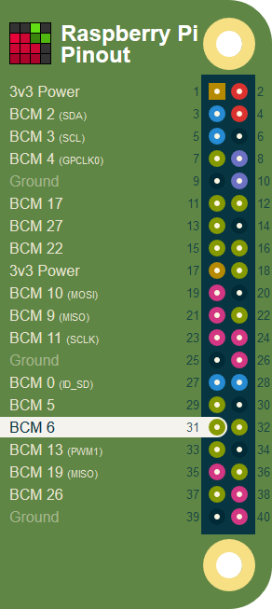
GPIO programming using python
BCM 6
Physical pin 31
BCM pin 6
Wiring Pi pin 22

Slide 44
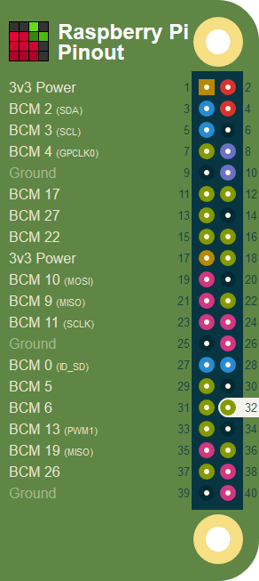
GPIO programming using python
BCM 12
Physical pin 32
BCM pin 12
Wiring Pi pin 26

Slide 45
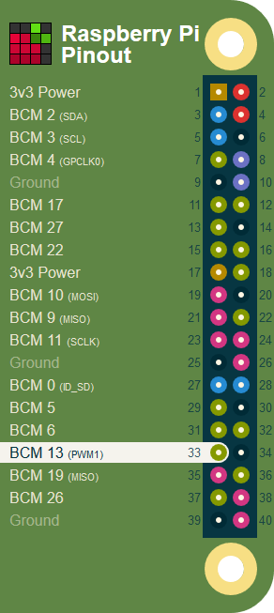
GPIO programming using python
BCM 13
Physical pin 33
BCM pin 13
Wiring Pi pin 23

Slide 46
GPIO programming using python
Ground
The Ground pins on the Raspberry Pi are all electrically connected, so it doesn't matter which one you use if you're wiring up a voltage supply.
Generally the one that's most convenient or closest to the rest of your connections is tidier and easier, or alternatively the one closest to the supply pin that you use.
For example, it's a good idea to use Physical Pin 17 for 3v3 and Physical Pin 25 for ground when using the SPI connections, as these are right next to the important pins for SPI0.
Details
1 pin header
Uses 8 GPIO pins

Slide 47
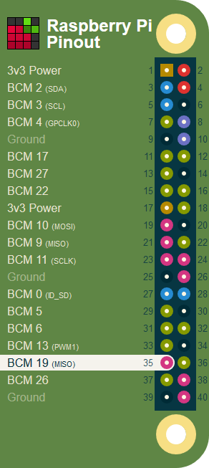
GPIO programming using python
BCM 19 (SPI Master-In)
Physical pin 35
BCM pin 19
Wiring Pi pin 24

Slide 48
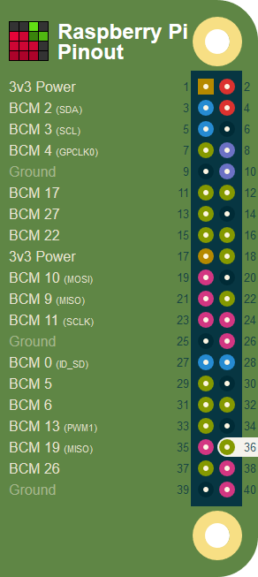
GPIO programming using python
BCM 16
Physical pin 36
BCM pin 16
Wiring Pi pin 27

Slide 49
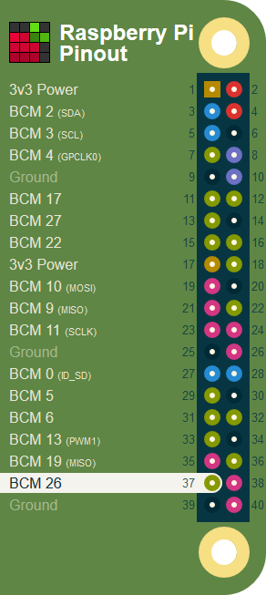
GPIO programming using python
BCM 26
Physical pin 37
BCM pin 26
Wiring Pi pin 25

Slide 50
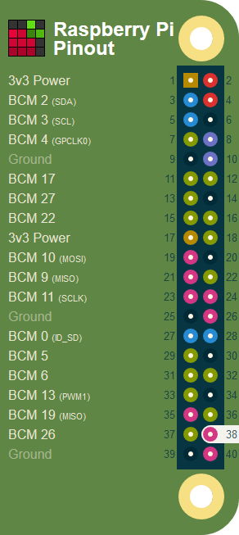
GPIO programming using python
BCM 20 (SPI Master-Out)
Physical pin 38
BCM pin 20
Wiring Pi pin 28

Slide 51
GPIO programming using python
Ground
The Ground pins on the Raspberry Pi are all electrically connected, so it doesn't matter which one you use if you're wiring up a voltage supply.
Generally the one that's most convenient or closest to the rest of your connections is tidier and easier, or alternatively the one closest to the supply pin that you use.
For example, it's a good idea to use Physical Pin 17 for 3v3 and Physical Pin 25 for ground when using the SPI connections, as these are right next to the important pins for SPI0.
Details
1 pin header
Uses 8 GPIO pins

Slide 52
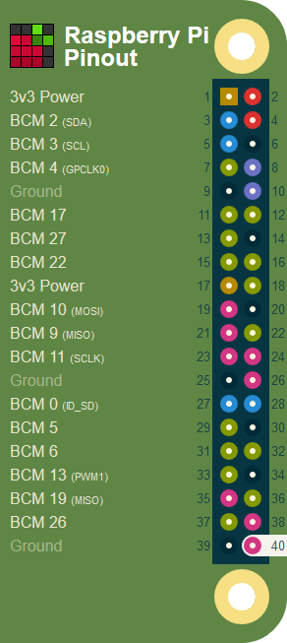
GPIO programming using python
BCM 21 (SPI Clock)
Physical pin 40
BCM pin 21
Wiring Pi pin 29

Slide 53
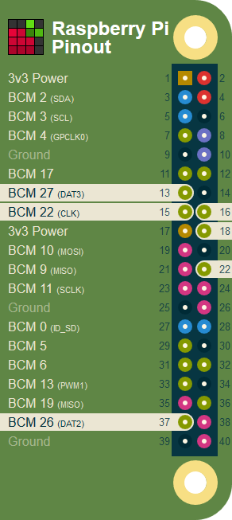
GPIO programming using python
SDIO - SD Card Interface
SDIO is the SD host/eMMC interface on the Raspberry Pi. SD host signals are normally used for the microSD slot.
These pins are "SD host" on Alt0 and "eMMC" on Alt3.
Details
Uses 6 GPIO pins

Slide 54
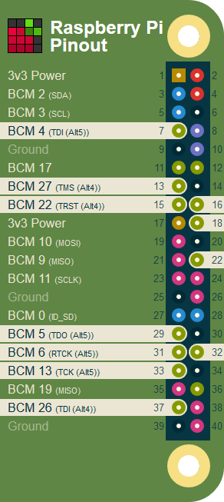
GPIO programming using python
JTAG - Joint Test Action Group
JTAG is a standardised interface for debugging integrated circuits which you can use to debug your Raspberry Pi.
Details
Uses 11 GPIO pins

Slide 55
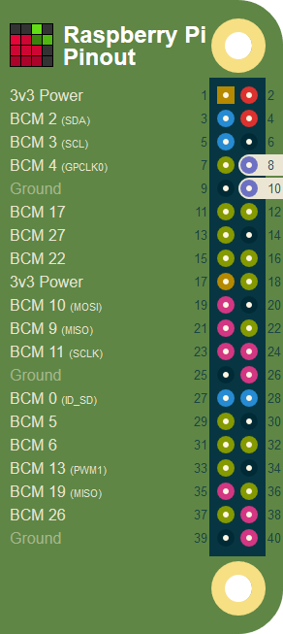
GPIO programming using python
UART - Universal Asynchronous Receiver/Transmitter
UART pins in BCM mode are: 14, 15
UART pins in WiringPi are: 15, 16

Slide 56
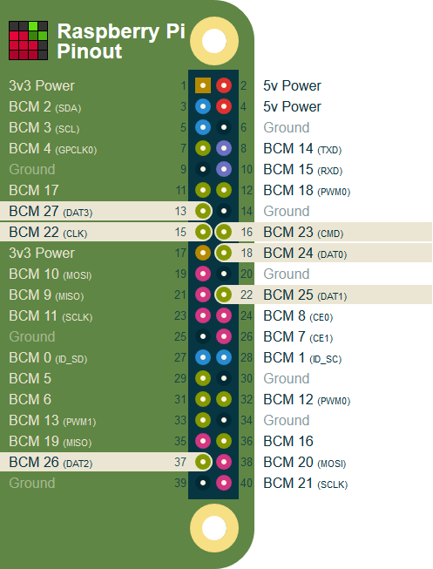
GPIO programming using python
SDIO - SD Card Interface
SDIO is the SD host/eMMC interface on the Raspberry Pi. SD host signals are normally used for the microSD slot.
These pins are "SD host" on Alt0 and "eMMC" on Alt3.

Slide 57
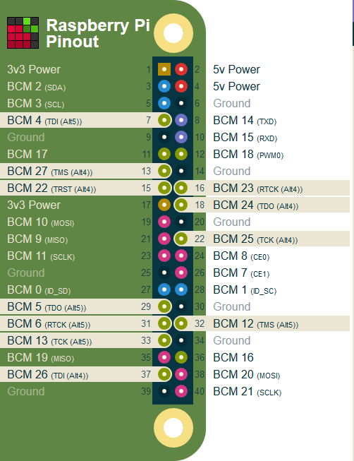
GPIO programming using python
JTAG - Joint Test Action Group
JTAG is a standardized interface for debugging integrated circuits which you can use to debug your Raspberry Pi.
Details
Uses 11 GPIO pins

Slide 58
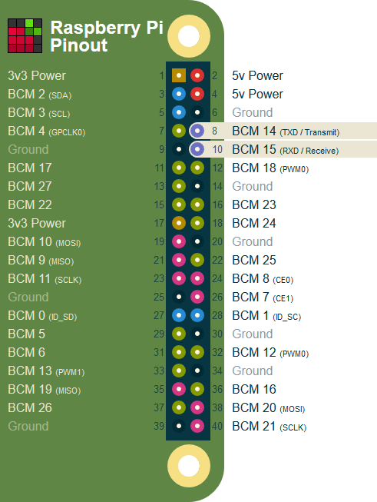
GPIO programming using python
UART - Universal Asynchronous Receiver/Transmitter
UART pins in BCM mode are: 14, 15
UART pins in WiringPi are: 15, 16
UART is an asynchronous serial communication protocol, meaning that it takes bytes of data and transmits the individual bits in a sequential fashion.

Slide 59
GPIO programming using python
Asynchronous transmission allows data to be transmitted without the sender having to send a clock signal to the receiver.
Instead, the sender and receiver agree on timing parameters in advance and special bits called 'start bits' are added to each word and used to synchronize the sending and receiving units.
UART is commonly used on the Pi as a convenient way to control it over the GPIO, or access the kernel boot messages from the serial console (enabled by default).

Slide 60
GPIO programming using python
It can also be used as a way to interface an Arduino, bootloaded ATmega, ESP8266, etc with your Pi. Be careful with logic-levels between the devices though, for example the Pi is 3.3v and the Arduino is 5v. Connect the two and you might conjure up some magic blue smoke.
Assuming you have WiringPi-Python installed, the following python example opens the Pi's UART at 9600baud and puts 'hello world'
import wiringpi
wiringpi.wiringPiSetup()
serial = wiringpi.serialOpen('/dev/ttyAMA0',9600)
wiringpi.serialPuts(serial,'hello world!')

Slide 61
GPIO programming using python
UART - Universal Asynchronous Receiver/Transmitter
UART is an asynchronous serial communication protocol, meaning that it takes bytes of data and transmits the individual bits in a sequential fashion.
Asynchronous transmission allows data to be transmitted without the sender having to send a clock signal to the receiver.
Instead, the sender and receiver agree on timing parameters in advance and special bits called 'start bits' are added to each word and used to synchronize the sending and receiving units.

Slide 62
GPIO programming using python
UART is commonly used on the Pi as a convenient way to control it over the GPIO, or access the kernel boot messages from the serial console (enabled by default).
It can also be used as a way to interface an Arduino, bootloaded ATmega, ESP8266, etc with your Pi.
Be careful with logic-levels between the devices though, for example the Pi is 3.3v and the Arduino is 5v.

Slide 63
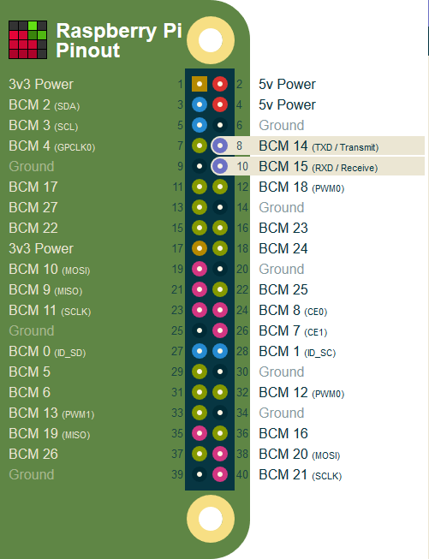
GPIO programming using python
Assuming you have WiringPi-Python installed, the following python example opens the Pi's UART at 9600baud and puts 'hello world'
import wiringpi
wiringpi.wiringPiSetup()
serial = wiringpi.serialOpen('/dev/ttyAMA0',9600)
wiringpi.serialPuts(serial,'hello world!')

Slide 64
GPIO programming using python
DPI - Display Parallel Interface
One of the alternate functions selectable on bank 0 of the Raspberry Pi GPIO is DPI.
DPI (Display Parallel Interface) is a 24-bit parallel interface with 28 clock and synchronization signals.

Slide 65
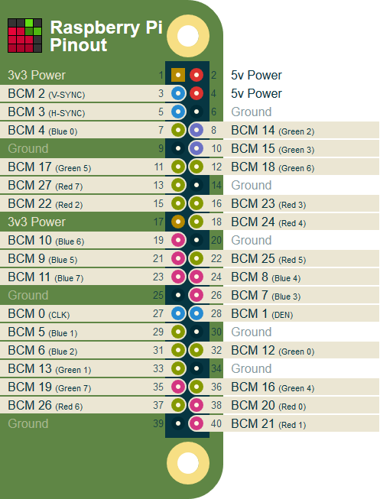
GPIO programming using python
This interface allows parallel RGB displays to be attached to the Raspberry Pi GPIO either in RGB24 (8 bits for red, green and blue) or RGB666 (6 bits per color) or RGB565 (5 bits red, 6 green, and 5 blue).
It is available as alternate function 2 (ALT2) on GPIO bank 0.
The pinout presented here is for the RGB24 mode.

Slide 66
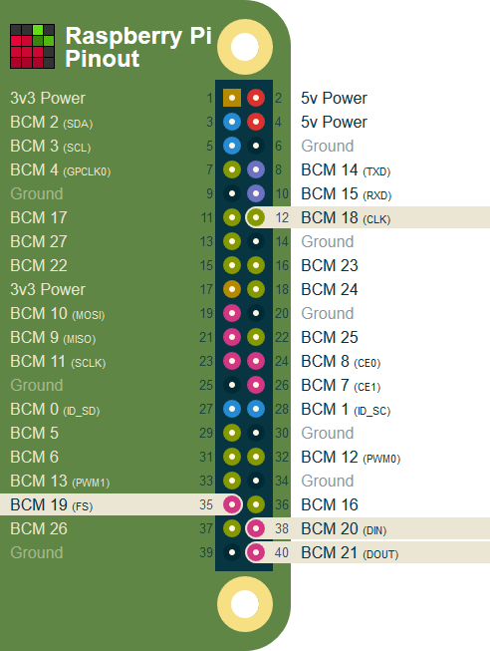
GPIO programming using python
PCM - Pulse-code Modulation
PCM (Pulse-code Modulation) is a digital representation of sampled analog. On the Raspberry Pi it's a form of digital audio output which can be understood by a DAC for high quality sound.

Slide 67
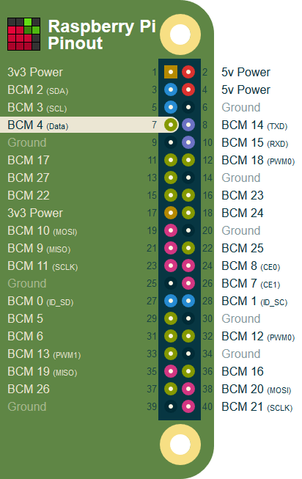
GPIO programming using python
W1-GPIO - One-Wire Interface
The Raspberry Pi has a 1-wire bus which can be enabled on GPIO4. It provides low-speed data, signaling, and power over a single conductor.
This is commonly used on the Pi to connect low-cost sensors devices such as the DS18B20 temperature sensor.

Slide 68
GPIO programming using python
WiringPi
WiringPi is an attempt to bring Arduino-wiring-like simplicity to the Raspberry Pi.
The goal is to have a single common platform and set of functions for accessing the Raspberry Pi GPIO across multiple languages.
WiringPi is a C library at heart, but it's available to both Ruby and Python users who can "gem install wiringpi" or "pip install WiringPi" respectively.

Slide 69
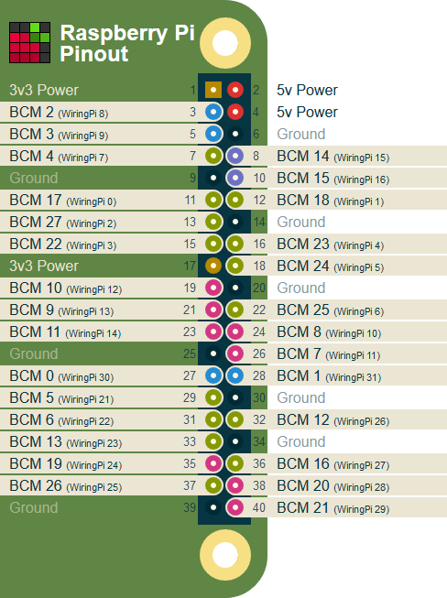
GPIO programming using python
Python users note the 2 on the end, the WiringPi-Python library finally brings a whole host of existing WiringPi functionality to Python including brand new features from WiringPi 2.
WiringPi uses its own pin numbering scheme, here you'll learn how WiringPi numbers your GPIO pins, what those pins do and how to do shiny things with them from within Python or Ruby.
sudo pip install WiringPi

Slide 70
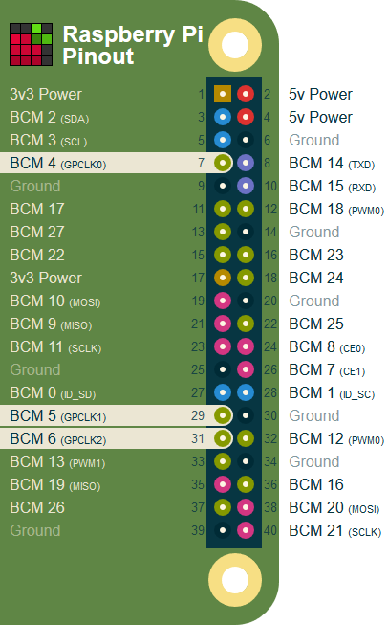
GPIO programming using python
GPCLK - General Purpose CLock
General Purpose Clock pins can be set up to output a fixed frequency without any ongoing software control.

Slide 71
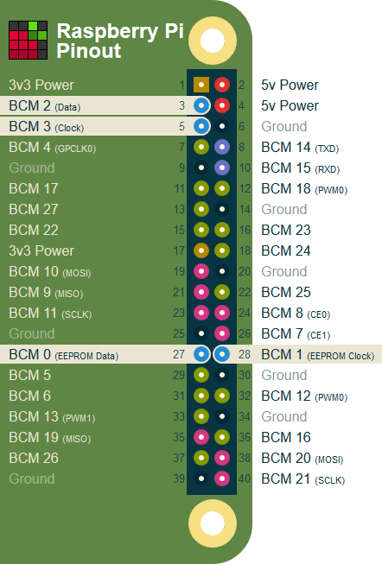
GPIO programming using python
I2C - Inter Integrated Circuit
I2C pins in BCM mode are: 2, 3
I2C pins in WiringPi are: 8, 9
The Raspberry Pi's I2C pins are an extremely useful way to talk to many different types of external peripheral; from the MCP23017 digital IO expander, to a connected ATmega.
The I2C pins include a fixed 1.8 kohms pull-up resistor to 3.3v. This means they are not suitable for use as general purpose IO where a pull-up is not required.

Slide 72
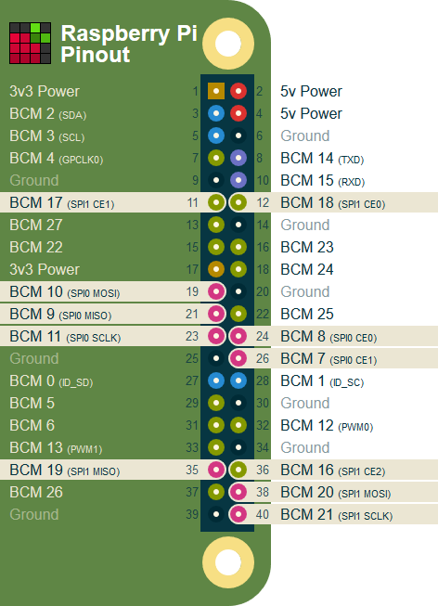
GPIO programming using python
SPI - Serial Peripheral Interface
SPI0 pins in BCM mode are: 9, 10, 11 + 7/8
SPI0 pins in WiringPi are: 12, 13, 14 + 10/11
Known as the four-wire serial bus, SPI lets you attach multiple compatible devices to a single set of pins by assigning them different chip-select pins.

Slide 73
GPIO programming using python
A useful example of an SPI peripheral is the MCP23S17 digital IO expander chip ( Note the S in place of the 0 found on the I2C version ).
You can also use the SPI port to "Bit-Bang" an ATmega 328, loading Arduino sketches onto it with Gordon Hendersons' modified version of AVRDude.
To talk to an SPI device, you assert its corresponding chip-select pin.

Slide 74
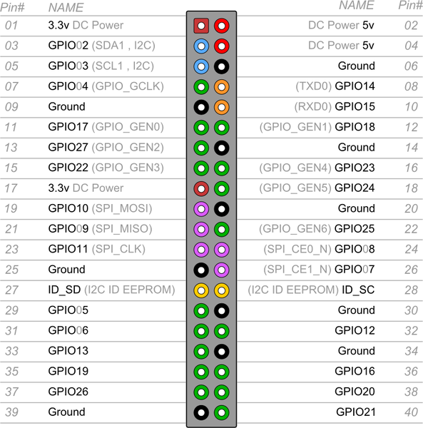
GPIO programming using python

